Slide 1
A Replication Study: Heart Failure Risk Factors and Survival
Lilian Zaplin
Student # 501209464
CIND 820: Big Data Analytics Project
Supervisor: Professor Tamer Abdou
December 4, 2023

Slide 2
Introduction
Background Electronic Health Records (EHR) contain patient lifestyle, symptoms, clinical laboratory tests, and survival data Machine learning models can be developed to predict patient survival for critical illness such as heart failure Machine learning models can be used to support medical doctors in patient management
Research Objectives Replication study is by Chicco and Jurman (2020) Develop machine learning model to predict the risk factors and survival of patients with heart failure comparable to replicated study. Address that results could be impacted by the significant imbalance in the dataset towards patients having survived (67.9% majority negative class) which was not addressed by authors. Show that better prediction accuracy could be shown by model using more than top two risk factors selected by authors. Improve performance metrics of project model compared to replication study by use of SMOTE+ENN to balance dataset and hyperparameter tuning of classifiers investigated.
Notes:
Introduction
Using datasets from electronic health records, data mining can be used to discover previously unknown correlations in patient data. Machine learning models are being developed to assess risk factors for chronic diseases such as diabetes, and to predict patient survival for critical illnesses such as heart failure and cancer. It is intended that these models be used to support medical doctors in patient management.
In my capstone project, I am replicating the work of Chicco and Jurman (2020) who developed a machine learning model to predict the survival of patients with heart failure using only the top two risk factors they had identified. Further to duplicating the analysis results, I addressed two issues: The first, was identified but not addressed by the authors which was that results could be impacted by the significant imbalance in the dataset towards patients having survived. And, second, that Ishaq et al., (2021) in a subsequent study using the same dataset, achieved a higher survival prediction accuracy by using more than just the top two ranked features.
My goal was to improve on the performance metrics of the replication study by using SMOTE+ENN to balance the dataset; performing hyperparameter tuning of the classifiers, and also identifying and using more than only the top two risk factors in my project model.

Slide 3
Data Description
Public dataset used availble from UCI Machine Learning Repository at http://archive.ics.uci.edu/dataset/519/hear+failure+clinical+records
The dataset contains the EHR of 299 patients with left ventricular systolic heart failure of which 105 are women and 194 are men.
The binary classification target is the event of death.
Dataset contains 13 features relating to patient clinical and lifestyle information:
Age, ejection fraction, creatinine phosphokinase, serum sodium, and time are integer
Platelets and serum creatinine are real
Anaemia, diabetes, high blood pressure, sex, and smoking are binary
There were no missing values or duplicates
Outliers occurred in all the numeric variables, except age and time, to varying degrees.
A significant imbalance exists in the dataset towards patients having survived (67.9% majority negative class).
Notes:
Data Description
Just a follow-up on the exploratory data analysis that was done. The Pearson’s correlation coefficient, that assesses linear relationships, was used to evaluate correlation between all the independent variables in the dataset, and no correlation was found. However, this was not the appropriate method for this dataset. In the case of continuous variables, when it is not known if the relationship is linear, and there are outliers present, Spearman's correlation should have been used. Furthermore, the chi-square test of independence should have been used to examine the relationship between categorical variables, as well as, the Kruskal-Wallis Test for relationships between continuous and categorical variables.

Slide 4
Methodology

Slide 5
Workflow | Steps
Data loading | - heart_failure_clinical_records_dataset - Drop time feature from data - Map variables to correct datatype and power
Data feature engineering | - Transform numeric data using Robust Scaler - Passthrough all binary data and features without outliers - Apply SMOTEENN
Data splitting | - Test size of 20% as per original study - No seed set - Stratify parameter set to y
Classifier hyperparameter tuning | - Defined hyperparameter grid to search - Grid Search Cross Validation using AUC-ROC scoring metric a. Tree-based (random forest and extra trees) b. Logistic regression c. AdaBoost
Model training & fitting | - Define the classifier: - random forest, extra trees, logistic regression, AdaBoost a. Default b. Tuned - Define model pipeline for preprocessing, classifier and feature selection 1. Imbalanced, complete dataset; classifier with default settings 2. Balanced, complete dataset; classifier with default settings 3. Balanced, complete dataset; tuned classifier Balanced dataset; select from model features using random forest as the base estimator; tuned RF classifier
Model evaluation | - Perform repeated stratified K-fold cross validation (10 repeats; 10 splits) - MCC, F1 Score, Accuracy, Balanced accuracy, Recall, Precision, AUC-ROC
Feature importance ranking | - Mean decrease in impurity method (tree classifiers) - Permutation importance method
Hypothesis statistical significance testing | - Shapiro-Wilk test to assess normality of data - One sample t test for normally distributed data - Wilcoxon signed-rank test for non-parametric data
Notes:
With Respect to Data Loading: It is important to note that I decided to exclude the time feature in my final analysis because the objective of the original study by Chicco and Jurman (2020) was to develop a model that doctors could use in a hospital setting to predict patient survival from the electronic health records available at that time. The time feature in the dataset was a measurement of days to a later follow-up visit and did not directly relate to the data collected during the patient’s initial stay in hospital. Furthermore, the time to follow-up would not strongly suggest any causality with the death event because it was set to a maximum value if follow-up had not yet occurred.

Slide 6
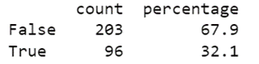
Data Feature Engineering SMOTE + ENN
A significant imbalance exists in the dataset towards patients having survived
SMOTE (Synthetic Minority Oversampling Technique) is a method of oversampling that generates new instances by interpolation between nearby positive instances.
ENN (edited nearest neighbors) is a method of under sampling that considers the three nearest neighbors of an instance. ENN removes a majority instance when it is misclassified based on its three nearest neighbors. If the instance is of the minority class, and it is misclassified based on its three nearest neighbors, then its nearest neighbors in the majority class are removed.
SMOTE + ENN is a hybrid technique that results in greater class distinction through data cleaning where misclassified instances of both classes are removed (Satpathy, 2023: What is Undersampling?, 2022).
Notes:
SMOTE+ENN
Ishaq et al. in their subsequent study using the heart failure clinical records dataset, addressed the imbalance in the dataset by using Synthetic Minority Oversampling Technique (SMOTE) to balance the dataset.
I wanted to expand on this approach by balancing the dataset using SMOTE+ENN.

Slide 7
Classifier Hyperparameter Tuning
Hyperparameter tuning of classifiers on datasets with no feature engineering
other than standardization, can achieve improvements in performance metrics of 3% to 50%.
(Olson et al., 2017)
Notes:
Classifier Hyperparameter Tuning
The goal of classifier hyperparameter tuning is to increase model accuracy along with decreasing both model overfitting and computational complexity.
In the case of the tree-based classifiers (Random Forest and Extra Trees) increased accuracy can be achieved by increasing the number of decision trees in the ensemble. Overfitting and computational complexity can be decreased by shallower trees with smaller number of leaf nodes in any tree; and, larger numbers of samples required with smaller numbers of features at a split node. Also, class weight parameters of balanced or balanced subsample are tuning parameters relating to the imbalanced dataset.

Slide 8
Results

Slide 9
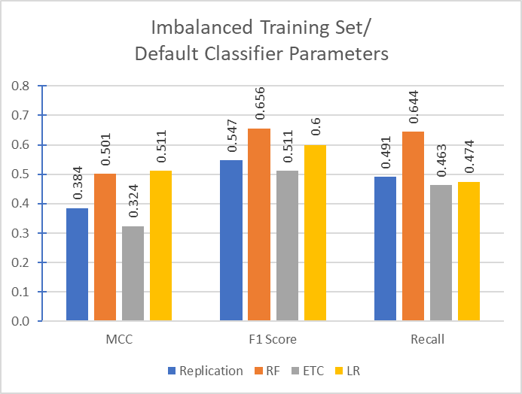
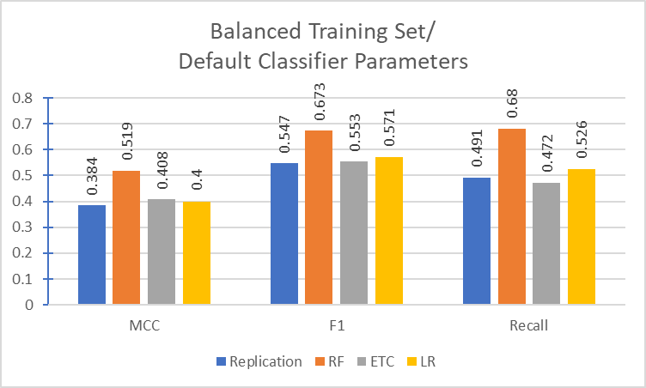
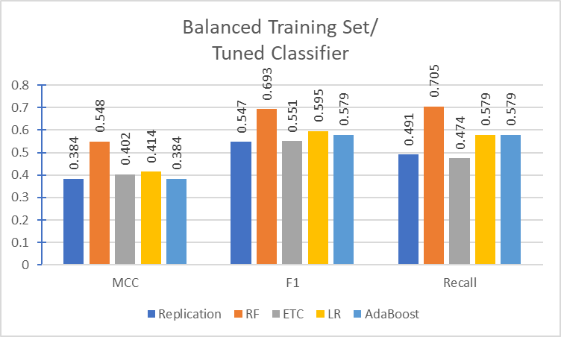
Tests of Default or Tuned Classifiers with Imbalanced or Balanced Datasets
Comparison of Project to Replication Study Results
ETC is significantly worst performing algorithm
with default parameters on imbalanced dataset
All classifiers with default setting showed significant
performance improvement when dataset balanced
RF performance improved significantly with tuning
AdaBoost(LR) degraded performance of LR alone
Notes:
Tests of Default or Tuned Classifiers with Imbalanced or Balanced Datasets
In a study by Olson et al. (2017) they stated that there is no silver bullet algorithm and that a suite of algorithms must be tested on a given dataset to see what works best.
Based on the results from the replication study and literature review, in my project study I used four algorithms: two tree-based—Random Forest and Extra Trees—one regression-based—Logistic Regression—and one ensemble method—AdaBoost with LR as the base estimator.
Three test conditions were set up to support my research and the results are shown. The first bar in the series represents values for the replication study, the next bar is RF, followed by ETC and the last bar in the series is LR.
TC1: The classifiers with default parameter settings were fitted to the complete, imbalanced dataset.
TC2: The dataset was balanced using SMOTE+ENN and the classifiers still with default parameter settings were fitted to the complete, now balanced dataset.
TC3: The classifiers and AdaBoost (with LR as the base estimator) now with tuned hyperparameters, were fitted to the complete, balanced dataset.
Model evaluation was done using K-fold cross validation wit 10 repeats and 10 splits.
ETC was the worst performing algorithm with default parameters on the imbalanced dataset.
All classifiers with default setting showed significant performance improvement when the dataset was balanced
RF performance improved significantly with tuning.
AdaBoost(LR) degraded the performance of LR.

Slide 10
Performance Effects of Balancing Dataset and Tuning Classifier Parameters
Balancing the dataset significantly increases the performance of tree-based classifier (RF and ETC)
but decreases the performance of regression-based LR.
Hyperparameter tuning did not further improve ETC performance
LR was the best performing algorithm in terms of stability and efficiency
Notes:
Performance Effects of Balancing Dataset and Tuning Classifier Parameters
Olson et al. (2017) further stated that hyperparameter tuning of classifiers on datasets with no feature engineering other than standardization, can achieve improvements in performance metrics of from 3 to 50%.
Here is a closer look at the behavior of the individual classifiers for the test conditions.
Balancing the dataset significantly increases the performance of tree-based classifiers (RF and ETC) but decreases the performance of regression-based LR.
Hyperparameter tuning did not further improve ETC performance
LR was the best performing algorithm in terms of stability and efficiency

Slide 11
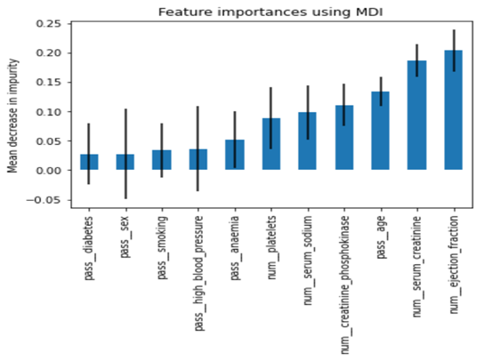
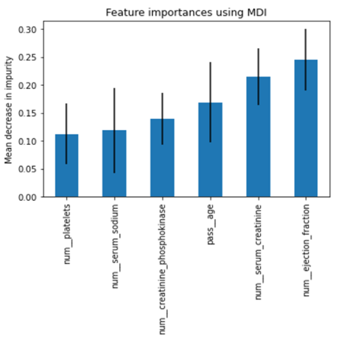
Random Forest and Select From Model Feature Selection
Random Forest Feature Selection
Select From Model (Random Forest)
Six best performing features based on feature importance ranking selected as input for final model:
Ejection fraction; Serum creatinine; Age; Creatinine phosphokinase; Serum Sodium, and Platelets
Notes:
RF and SFM Feature Selection
My study, the replication, and the subsequent study being reviewed, all had tree-based algorithms for their final models. In all cases, the mean decrease in impurity method was used to determine the ranking of the most important features in the model.
The six best features from my final model are the same as for Ishaq et al. (2021).

Slide 12
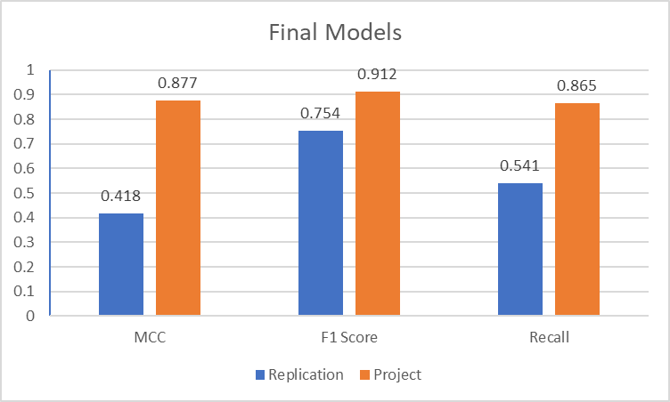
Final Models for Replication and Project
Selected Features
Replication Study (2):
Serum Creatinine,
Ejection Fraction
Project Study (6):
Ejection Fraction,
Serum Creatinine,
Age,
Creatinine Phosphokinase,
Serum Sodium,
Platelets
Significantly Better Performance Scores in Project Final Model due to:
SMOTE+ENN to balance dataset;
Hyperparameter tuning of Random Forest classifier;
Not limiting the best performing features for use in the final model to only the top two.
Notes:
Final Models for Replication and Project
Significantly better performance scores in my final model are due to:
Use SMOTE+ENN to balance the dataset
Hyperparameter tuning of RF
Not limiting the best performing features for use in the final model to only the top two
The findings by Chicco and Jurman, Ishaq et al., and my own results agree that serum creatinine and ejection fraction are the two most critical risk factors. However, heart failure is a complex condition influenced by various factors. From the literature review, the other features, creatinine phosphokinase, serum sodium, and changes in platelet count can be present in heart failure. Also, from the literature review, there was consensus that other features which are non-indicators such as diabetes and high blood pressure are likely pre-existing conditions that are already being managed.

Slide 13
Limitations Small dataset size of 299 records Dataset bias representing Pakistani demographic Impact from other, yet unconsidered variables No investigation of male and female subsets
Ethical Considerations Patient privacy and confidentiality Informed consent Data security, integrity and exchange Long-term retention and de-identification
Conclusion Electronic Health Records were the source of data for this project and its related studies. Modelling was done by traditional and ensemble machine learning methods. In the future, multimodal health care data from disparate sources including genomics, clinical notes, time series, demographics, and lab and imaging values, will be used to develop multimodal machine learning models. It can be expected that precision health will become a viable tool for diagnostic use by healthcare practitioners in a clinical setting.
Closing Remarks
Notes:
Closing Remarks
The Personal Health Information Protection Act (PHIPA) is a piece of legislation in the province of Ontario, Canada enacted in 2004 to govern the collection, use, and disclosure of personal health information by any organization responsible for the stewardship of personal data.
A clinical diagnosis made by medical doctors may fail to consider the relative weighting and relationships of the disparate data sources including genomics, clinical notes, time series, demographics, lab values and imaging, resulting in a one-size-fits-all treatment per disorder.
Precision health is an approach intended to customize a patient’s healthcare (decisions, treatments, practices, etc.) based on their individual phenotype, the interaction of their genotype with their environment.

